Slide 1
A core Course on Modeling
Introduction to Modeling
0LAB0 0LBB0 0LCB0 0LDB0
c.w.a.m.v.overveld@tue.nl
v.a.j.borghuis@tue.nl
S.13

Slide 2
Conceptualization phase: the property ‘when’
define
formulate
purpose
conceptualize
identify
entities
choose
relations
formalize
obtain
values
formalize
relations
execute
operate
model
obtain
result
conclude
present
result
interpret
result
Notes:
2

Slide 3
Conceptualization phase: the relation ‘before’
define
formulate
purpose
conceptualize
identify
entities
choose
relations
formalize
obtain
values
formalize
relations
execute
operate
model
obtain
result
conclude
present
result
interpret
result
Notes:
3

Slide 4
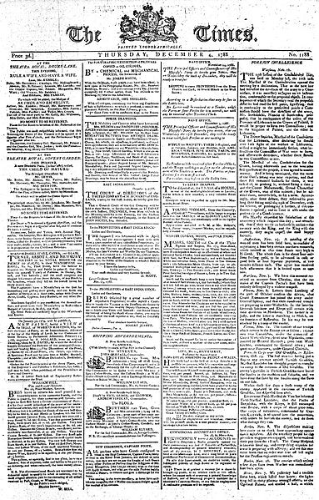
The New York Times
The London Times
Le Temps
Die Zeit
De Tijd
...
http://commons.wikimedia.org/wiki/File:Times_1788.12.04.jpg
Notes:
4
Almost in every country, significant newspapers are named in relation to time. The German word for newspaper is ‘Zeitung’ , from the word ‘Zeit’ for ‘time’. Why? What is the purpose of newspapers: to inform about change. And change, apparently, is invariably related to time. Without time no change. Perhaps even the opposite is true: without change, no time.
In the lectures in this chapter we will look at time and change from the perspective of the modeler: how to deal with situations that cary. Indeed, we remember that the previous chapter gave us the language to talk about concepts and their properties having values. But perhaps these values are not the same for ever.

Slide 5
State:
representation
of a system
in terms of
concepts
properties
values
http://commons.wikimedia.org/wiki/File:Phenakistoscope_3g07690a.gif
Process:
a sequence of states
Notes:
5
To talk about change we must distinguish the situation before the change from the situation after the change. Such situations will be called ‘states’. A state describes a system by listing, for every concept, and for every property of every concept, its value. Everything is known about the system. At least, as long as nothing changes.
If things change, we call this a process. The simplest way to talk about a process of change is therefore to regard it as a sequence of states.

